Slide 1
Internship Presentation
Dalia Jeiroudi
July 2021

Slide 2
About Me
Name: Dalia Jeiroudi
University: Boston College
  Major: Computer Science B.S
  Class of 2023
Boston Office – United States
  Software Engineering Intern
  Joined May 17th
Business Unit: SVG
  Parser and Build Performance Team
  Managed by Francoise Martinolle
  Mentors/buddies: Rohit Kulkarni & Jon Lee

Slide 3

Compiler architecture
function f; {
int r = r + 1;
return r;
}
Lexer
Syntax recognition
Semantic analysis
parser
AST
Quad generation
Optimizer
Instruction generation
Code generator
Machine code

Slide 4
Parser
Input files contain text following
Specific language syntax rules
Parser: tool which converts input
Into internal representation
AST: Abstract Syntax Tree is the
internal representation of the source
Input source
Parser
AST

Slide 5
My Project: Class Generator
Goal:
  Create C++ data structures equivalent to the existing C structures that represent the abstract syntax tree (AST) used by the Xcelium systemVerilog parser (aka VST)
  Provide APIs to convert a C++ data structure to its equivalent VST data structure
  Automatic creation of data structures and APIs
Input : YAML definition of the existing VST
Output: C++ class hierarchy of the VST
  Started off translating YAML files into C++ using the yaml-cpp github repository.
  then began generating classes for the VST structures
  Used C++ because there are a lot of features which are more useful than the original C structures such as visitors to create traversals of the AST/VST

Slide 6
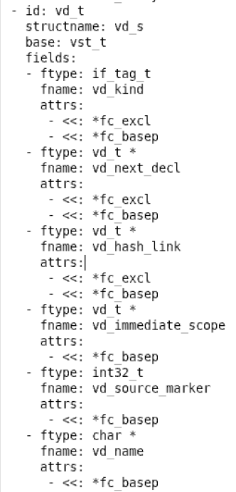
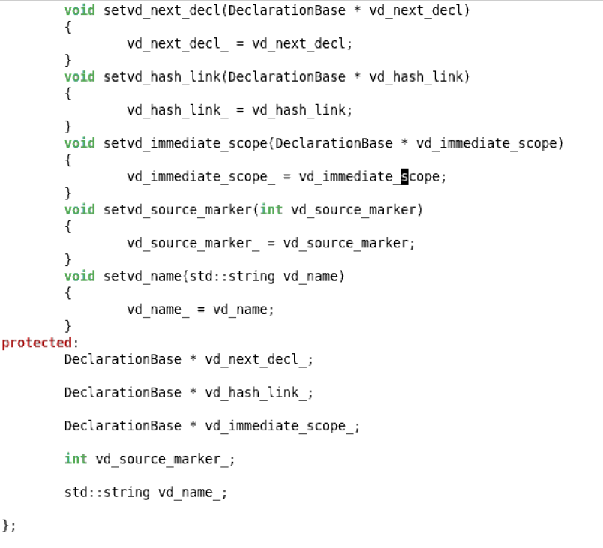
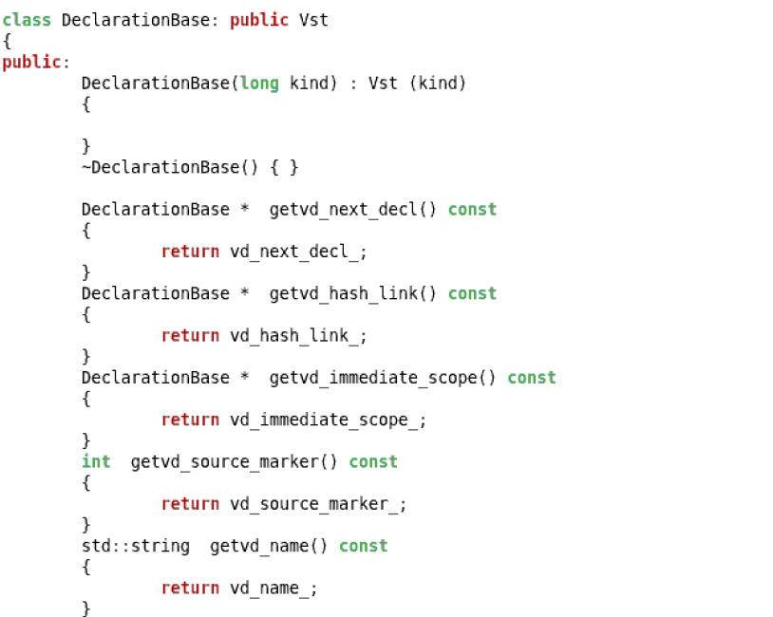
YAML definition
C++ Class
Notes:
When translating the YAML definitions into classes I first changed the struct names to something that was easier to understand. Then made sure each new class was correctly derived from its corresponding base class.

Slide 7
YAML definition
C++ Class
Notes:
Then I made sure the new struct names were reflected whenever the old one was used in field types or constructors.

Slide 8
YAML definition
C++ Class
Notes:
Lastly I generated getters and setters for each field in the structures as well as making them all protected class members so that they will be accessible to classes derived from them

Slide 9
Class Hierarchy Structure
Vst
DeclerationBase
ExpressionBase
StatementBase
DataTypeBase
UnameBase
VdModule
VeIdentifier
VsBa
VtDynamicArray
UeSimpleName
VdConfig
VeTyperef
VsNba
VtArray
UeDottedName
VdPackage
VeScopedIdentifier
VsIf
VtQueue
UeAppliedName

Slide 10
Impact of my Project
  The current parser works on old C data structures which places a lot of constraints on development. This infrastructure has not changed since it’s been developed.
  Goal – Generate a hierarchical class representation for the traditional data structures.
  Future Impact – Deploy these classes in the parser and synthesize C++ classes instead of C data structures for the AST.
  Using C++ for the core data structures allows us to leverage the object oriented power of C++ as well as utilize the various C++ libraries such as STL containers.

Slide 11
Exciting and challenging things so far
Trained in C++ (Coursera license)
‘Meeting’ employees and other interns
Getting instructions over a phone call
Still more to come!!!
  Hackathon
  Outcome of project

Slide 12
Skills & knowledge I’ve gained
Learnt C++
Learnt more about compilers and parsers
Understand Object oriented programming better
Learnt how to operate a virtual machine and used a Linux OS for the first time
Used a debugging tool for the first time
Used a GitHub repository for the first time
  YAML-Cpp

